Slide 1
Indian Medalists in
Paris Olympic 2024

Slide 2
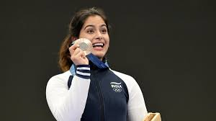
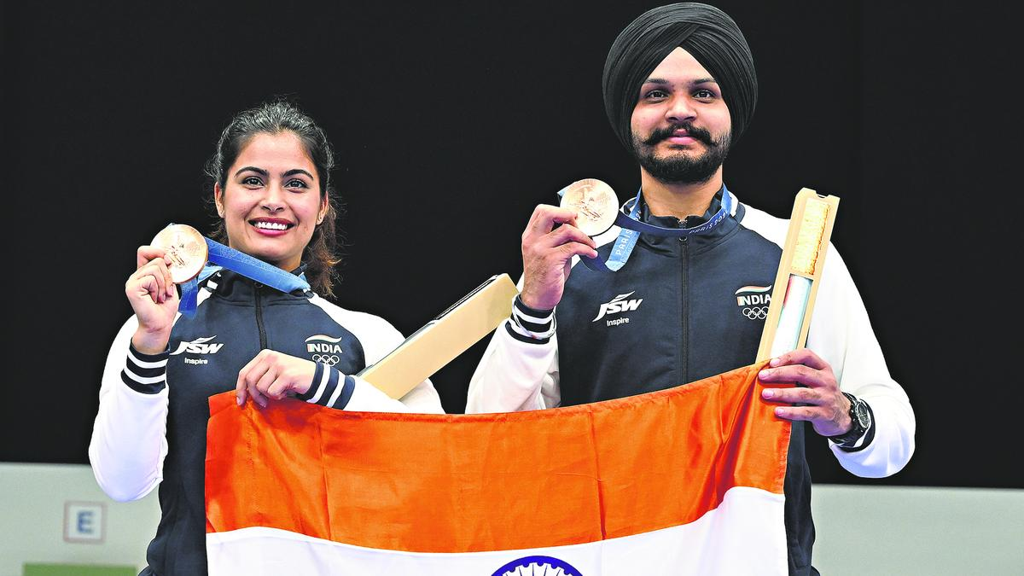
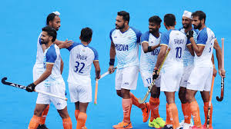
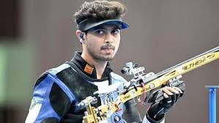
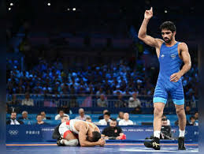
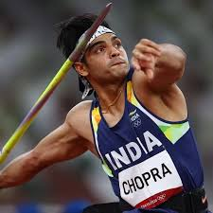
Indian Medalists in
Paris Olympic 2024
Manu Bhaker
Bronze medalist
On 10M shooting
Manu bhaker & sarabjeet singh
Bronze medalist in 10M shooting
Hockey team
Bronze medalist
Swapnil Kusale
Bronze medal in 50M rifle
Aman sherawat
Bronze medal wrestling 57kg
Neeraj Chopra
Silver medalist
On Javelin throw

Slide 3
Manu Bhaker
Bronze medalist
On 10M shooting
Manu bhaker & sarabjeet singh
Bronze medalist in 10M shooting
Hockey team
Bronze medalist
Swapnil Kusale
Bronze medal in 50M rifle
Aman sherawat
Bronze medal wrestling 57kg
Neeraj Chopra
Silver medalist
On Javelin throw

Slide 4
Manu Bhaker
Bronze medalist
On 10M shooting
Manu bhaker & sarabjeet singh
Bronze medalist in 10M shooting
Hockey team
Bronze medalist
Swapnil Kusale
Bronze medal in 50M rifle
Aman sherawat
Bronze medal wrestling 57kg
Neeraj Chopra
Silver medalist
On Javelin throw

Slide 5
Manu bhaker & sarabjeet singh
Bronze medalist in 10M shooting
Manu Bhaker
Bronze medalist
On 10M shooting
Hockey team
Bronze medalist
Swapnil Kusale
Bronze medal in 50M rifle
Aman sherawat
Bronze medal wrestling 57kg
Neeraj Chopra
Silver medalist
On Javelin throw

Slide 6
Manu bhaker & sarabjeet singh
Bronze medalist in 10M shooting
Manu Bhaker
Bronze medalist
On 10M shooting
Hockey team
Bronze medalist
Swapnil Kusale
Bronze medal in 50M rifle
Aman sherawat
Bronze medal wrestling 57kg
Neeraj Chopra
Silver medalist
On Javelin throw

Slide 7
Manu bhaker & sarabjeet singh
Bronze medalist in 10M shooting
Manu Bhaker
Bronze medalist
On 10M shooting
Hockey team
Bronze medalist
Swapnil Kusale
Bronze medal in 50M rifle
Aman sherawat
Bronze medal wrestling 57kg
Neeraj Chopra
Silver medalist
On Javelin throw

Slide 8
Manu bhaker & sarabjeet singh
Bronze medalist in 10M shooting
Manu Bhaker
Bronze medalist
On 10M shooting
Hockey team
Bronze medalist
Swapnil Kusale
Bronze medal in 50M rifle
Aman sherawat
Bronze medal wrestling 57kg
Neeraj Chopra
Silver medalist
On Javelin throw

